Slide 1


Testing
Day 02

Slide 2

Agenda
01
Testing Types
04
Test Management
02
Regression Testing
05
Defect Management
06
Test Tools
03
Testing Methods

Slide 3



Testing Types

Slide 4
Testing Types
01
02
03
04
Functional Testing
Non Functional Testing
Regression Testing
Re-Testing
Load Testing
Stress Testing
Security Testing
Compatibility Testing
Usability Testing
Notes:
Agenda/Objective + Description Slide (Layout#01)

Slide 5

Testing Methods

Slide 6


Testing Methods
Static Testing
Dynamic Testing

Slide 7


Static Testing
Why Static Testing?
The Review Process
The Review Types
Notes:
Full Screen Image with Bulleted list

Slide 8





The Review Process
Issue Communication and analysis
Initiate Review
Planning
Individual Review
Fixing and Reporting

Slide 9
The Review Types
Informal
Walkthrough
Technical Review
Inspection
Low
Level of formality
High

Slide 10

Dynamic Testing

Slide 11
Dynamic Testing
Black-Box Testing
Boundary Value Analysis
Equivalence Partitioning
Decision Table Testing
State Transition Testing
Use Case Testing
White-Box Testing
Statement Coverage
Decision Coverage
Path Coverage

Slide 12

Black Box Testing

Slide 13
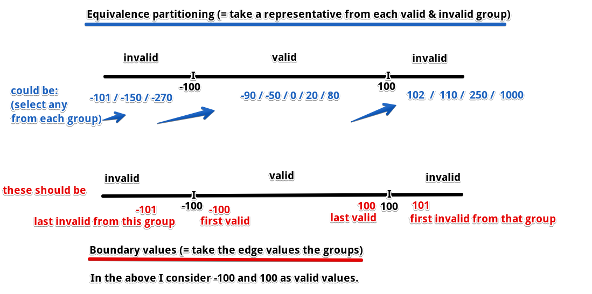
Black-Box Testing
Boundary value analysis Vs Equivalence partitioning

Slide 14
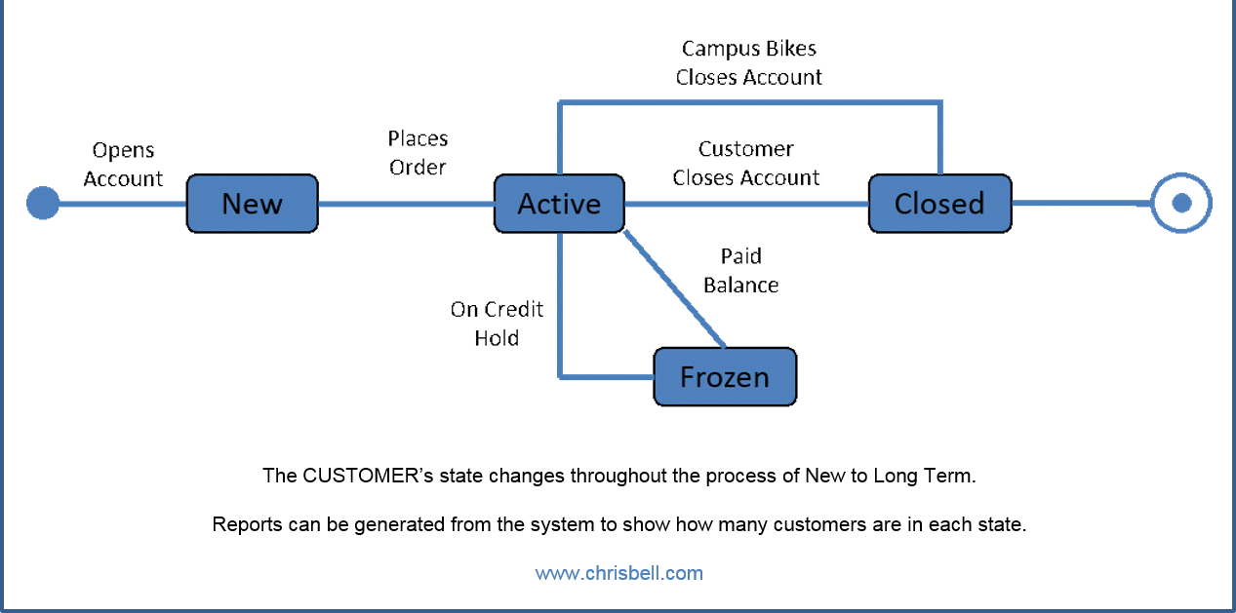
Black-Box Testing
State transition testing

Slide 15
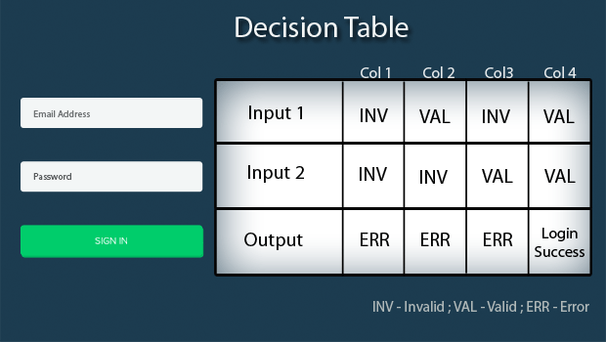
Black-Box Testing
Decision table testing

Slide 16
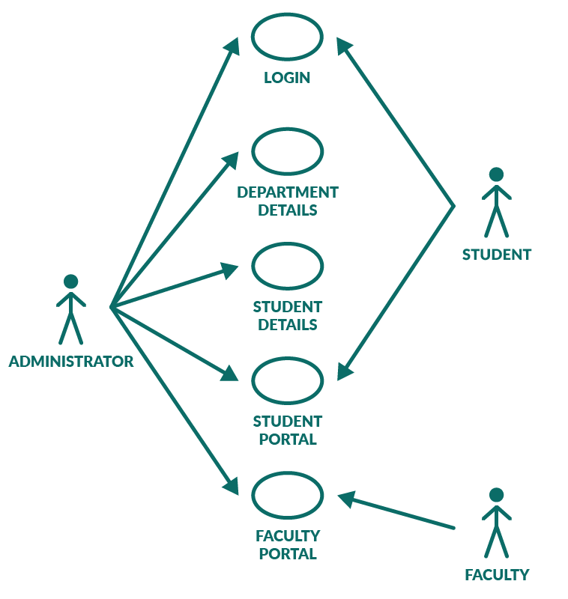
Black-Box Testing
Use-case testing

Slide 17
White Box Testing

Slide 18
White-Box Testing
Number of executed statements
Statement coverage =
x100%
Total number of statements
Number of test outcomes during test
Decision coverage =
x100%
Total number of possible decision
outcomes in the test object
Path coverage - dependencies between branches

Slide 19

Test Management

Slide 20
Test Management
Evaluate and report test results
Define/Adjust the testing strategy
Plan test execution
Evaluate and report test results
Test Planning and Control
Test Report

Slide 21
Defect Management

Slide 22
Defect Management
Test result evaluation
Test case shows expected <> actual
Test case shows expected == actual
Test case shows expected <> actual
Test case shows expected == actual
False negative
Test object correct
True negative
Evaluating Test Reports
Test case “failed”
Test case “passed”
True positive
Test object faulty
False positive

Slide 23
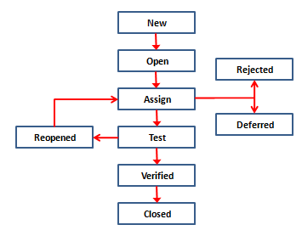
Defect Management
Defect Lifecycle

Slide 24
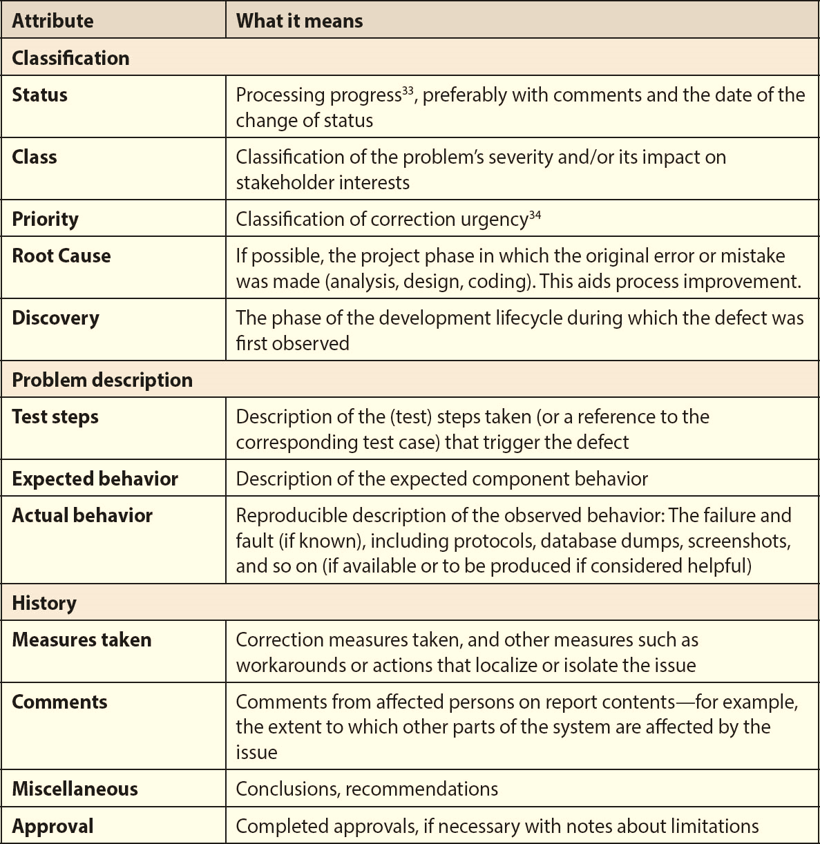
Defect Management
Defect Report Template

Slide 25
Test Tools

Slide 26
Test Tools
Test Management tools
Test Automation Tools
Requirement Management
Test Execution
Incident Management

Slide 27
Thank You!
Copyright © HeroX Private Limited, 2022. All rights reserved.

